Slide 1
BB
Aaron De Clercq
Leontii Shtokolenko
Anne van der Weijden
Souvik Chakraborty

Slide 2


Introduction
Barabasi - Albert Model:
Scale free
Power law
Hubs
Growth and Preferential Attachment

Slide 3
Discrepancy:
Nodes which come in later can also take over in reality

Slide 4

Bianconi Barabasi Model
Each node has a “Fitness”
Later nodes with high fitness can become hubs

Slide 5
Research question
How fitness distribution impacts the Bianconi-Barabasi degree distribution?
Can we estimate real-world network fitness distribution from node degree evolution?
Can we retrieve the phase transition where the topology of the network changes?

Slide 6
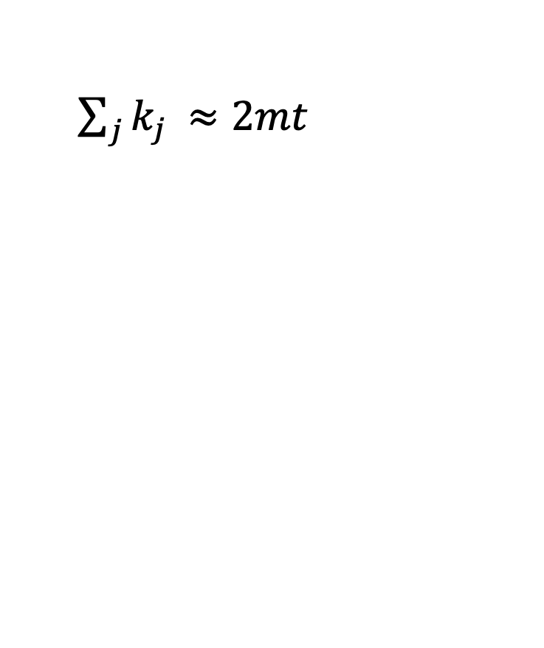
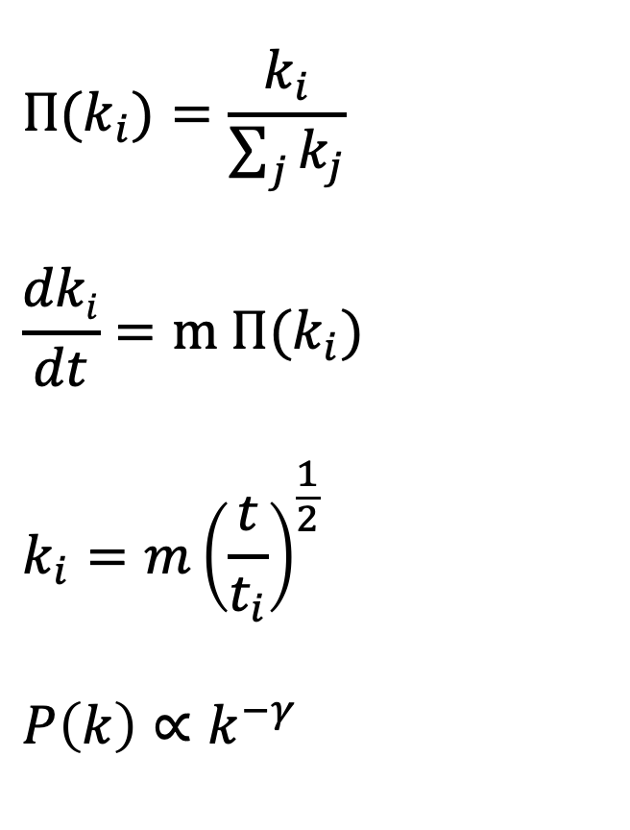
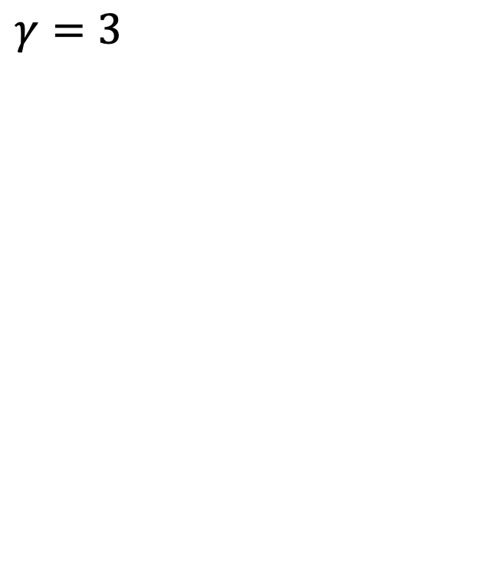
Theoretical overview: Barabasi-Albert
$${Π(k}_{i})=\frac{k_{i}}{\sum_{j}{k_{j}}}$$
$$\frac{dki}{dt}=m {Π(k}_{i})$$
$$k_{i}={m\left(\frac{t}{t_{i}}\right)}^{\frac{1}{2}}$$
$$P\left(k\right)∝k^{−γ}$$
$\sum_{j}{k_{j }≈2mt}$
$γ=3$

Slide 7
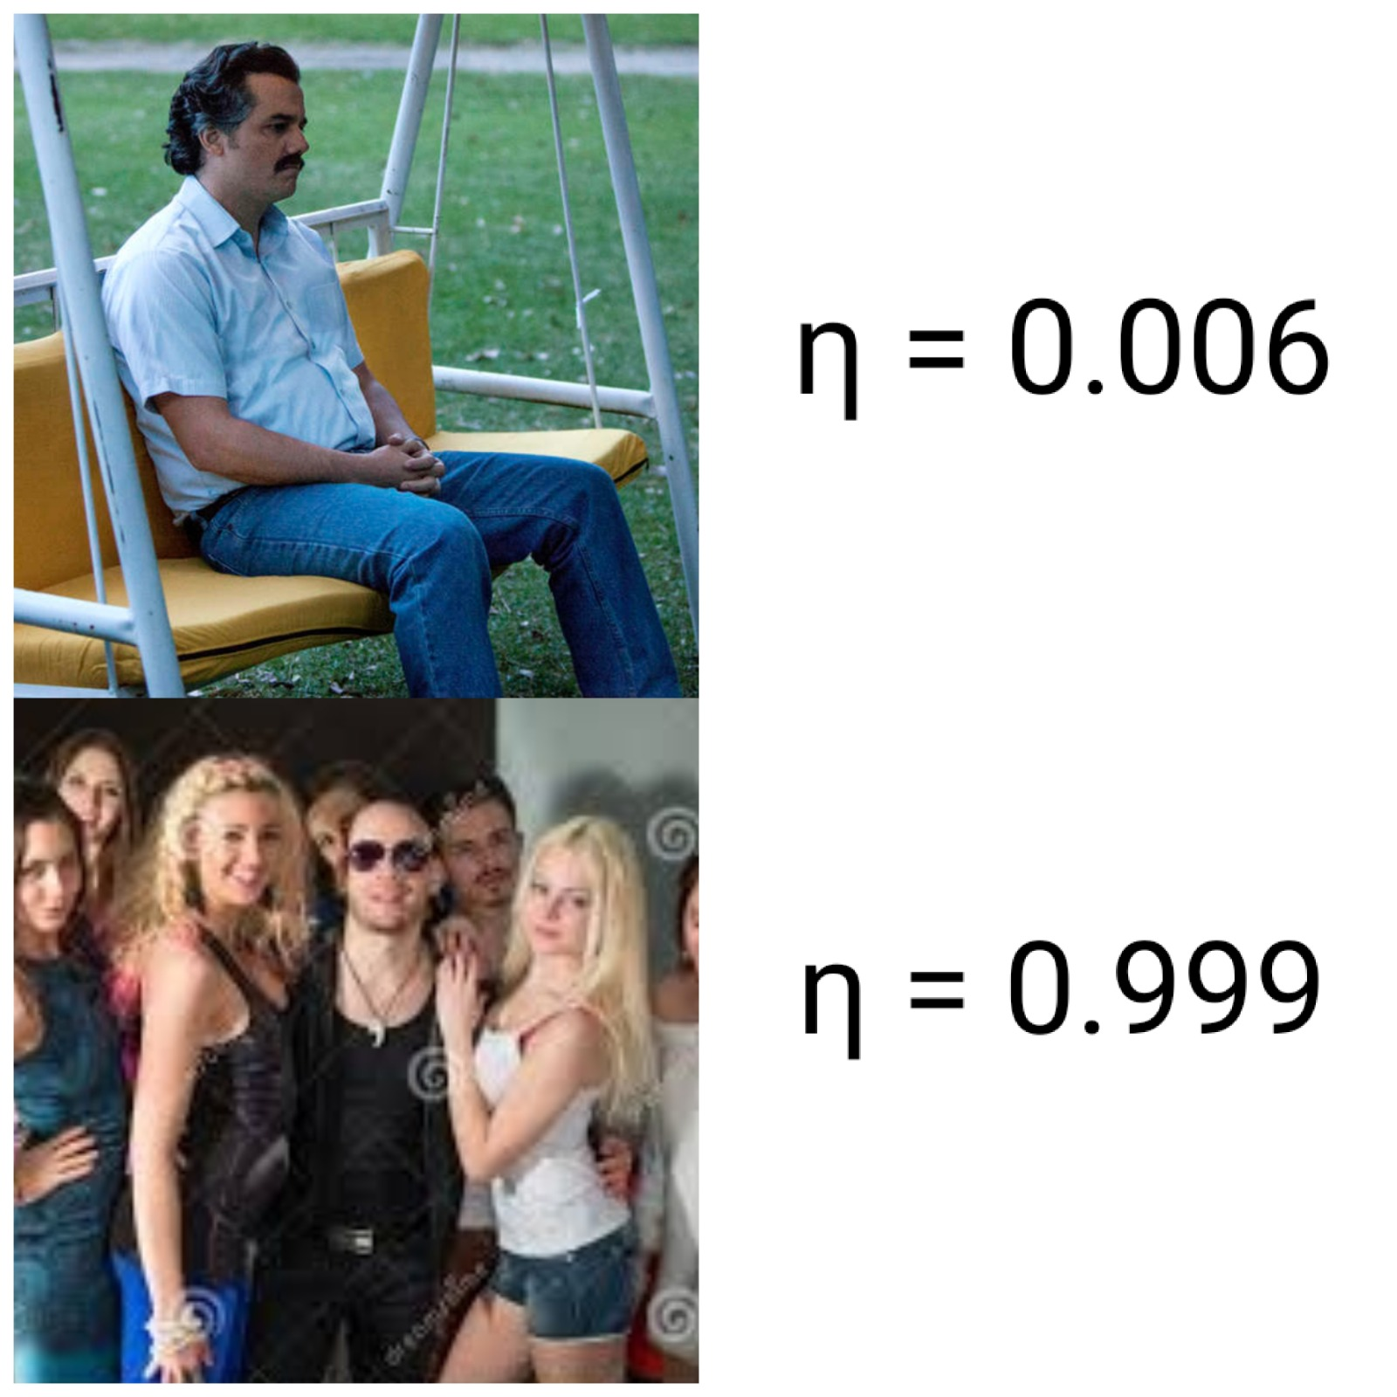
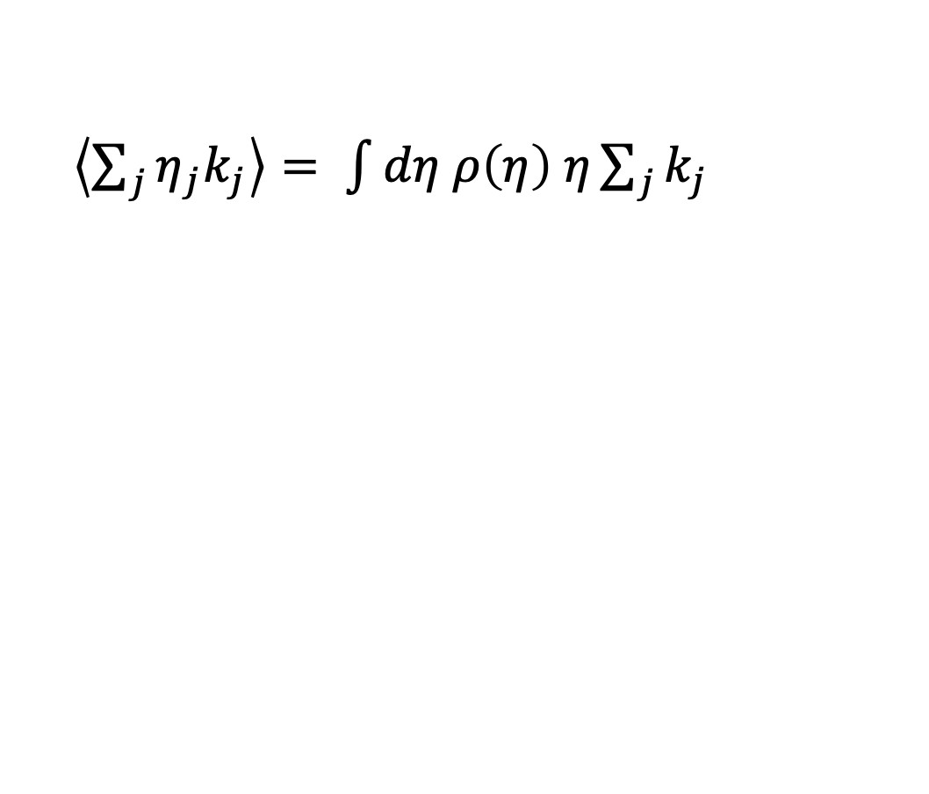
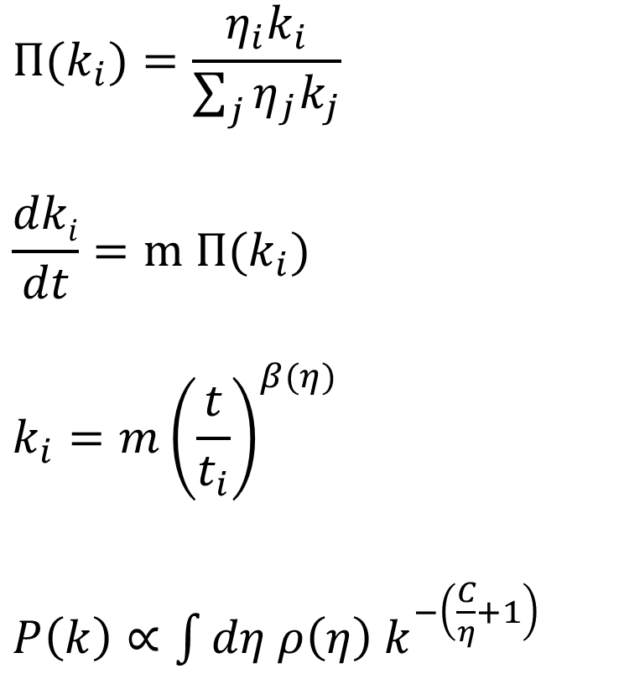
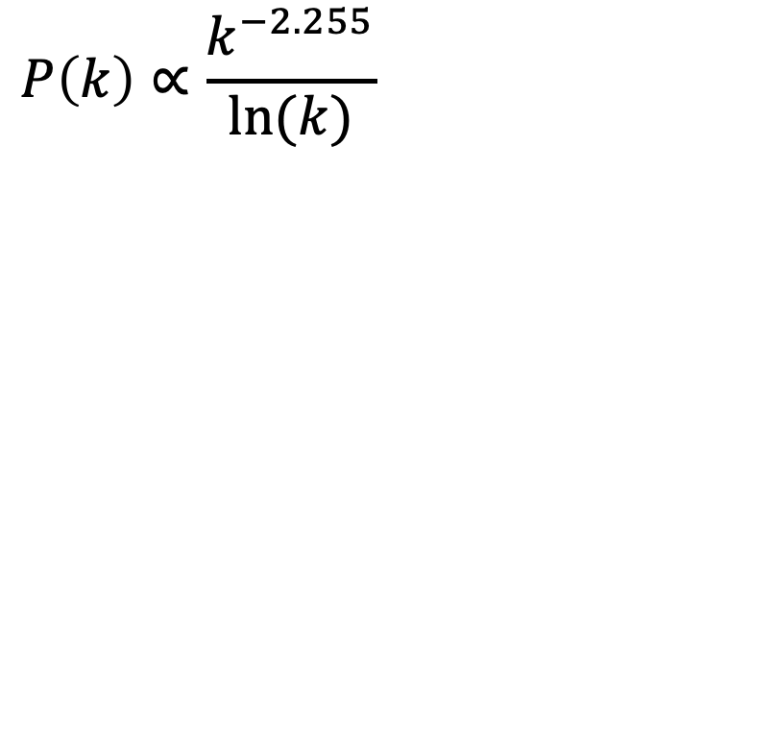
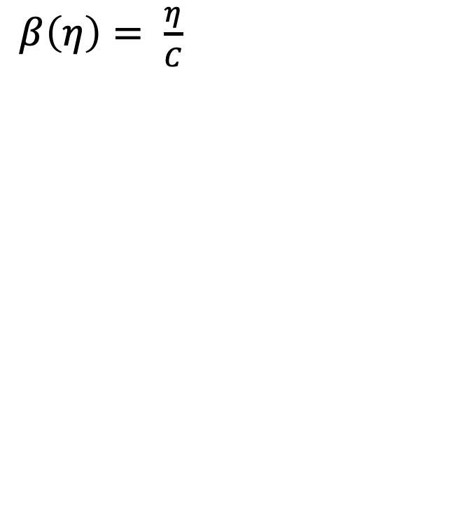
Theoretical overview: Bianconi-Barabasi
$${Π(k}_{i})=\frac{η_{i}k_{i}}{\sum_{j}{η_{j}k_{j}}}$$
$$\frac{dki}{dt}=m {Π(k}_{i})$$
$$k_{i}={m\left(\frac{t}{t_{i}}\right)}^{β(η)}$$
$P\left(k\right)∝\int{dη ρ\left(η\right) k^{−\left(\frac{C}{η}+1\right)}}$
$\left\langle \sum_{j}{η_{j}k_{j}}\right\rangle = \int{dη ρ\left(η\right) η\sum_{j}{k_{j}}}$
$β\left(η\right)= \frac{η}{C}$
$$P\left(k\right)∝\frac{k^{−2.255}}{ln⁡(k)}$$

Slide 8
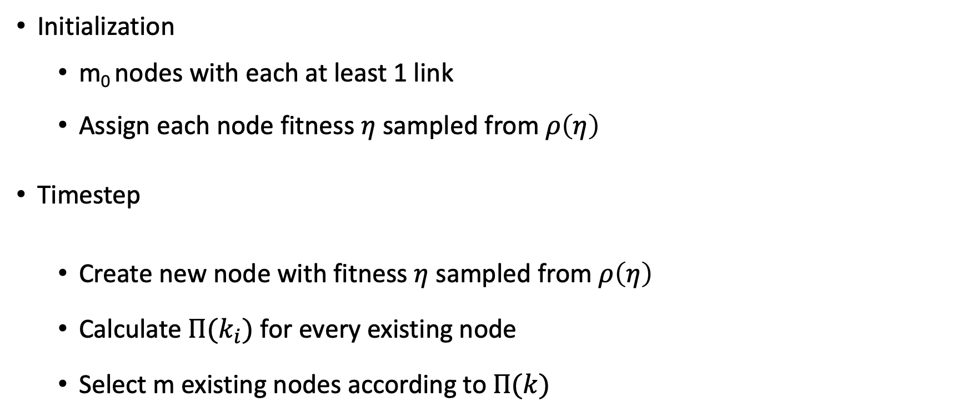
Model implementation
Initialization
m₀ nodes with each at least 1 link
Assign each node fitness $η$ sampled from $ρ\left(η\right)$
Timestep
Create new node with fitness $η$ sampled from $ρ\left(η\right)$
Calculate ${Π(k}_{i})$ for every existing node
Select m existing nodes according to$Π(k)$

Slide 9
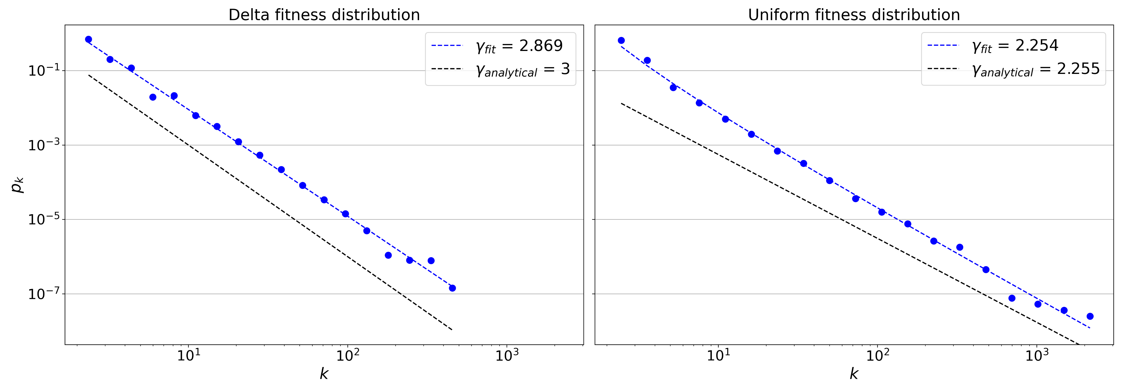
Analysis: Degree distributions
N= 50,000 , m₀ = 3 , m= 2

Slide 10
Delta:
Analysis: Degree distributions
 | Power law | Truncated power law | Stretched exponential | Lognormal | Exponential | Lognormal positive
Truncated powerlaw | R + Significant | --- | R+ Not significant | R+ Not significant | R+ Significant | R+ Significant
Power Law | --- | R-, Significant | R-, Not significant | R-, Not significant | R+, Significant | R+ Significant
Stretched Exponential | R+ Not significant | R-, Not significant | --- | R+ Not significant | R + Significant | R + Significant
Uniform:
 | Power law | Truncated power law | Stretched exponential | Lognormal | Exponential | Lognormal positive
Truncated powerlaw | R + Significant | --- | R+ Not significant | R+ Not significant | R+ Significant | R+ Significant
Power Law | --- | R-, Significant | R-, Not significant | R+ Not significant | R+, Significant | R+ Significant
Stretched Exponential | R+ Not significant | R-, Not significant | --- | R+ Not significant | R + Significant | R + Significant
Notes:
Delta: Calculating best minimal value for power law fit
truncated_power_law vs power_law: R = 1.6533, p = 0.0097
truncated_power_law vs lognormal: R = 2.0899, p = 0.0366
truncated_power_law vs exponential: R = 3.6583, p = 0.0003
truncated_power_law vs lognormal_positive: R = 643.4221, p = 0.0
truncated_power_law vs stretched_exponential: R = 1.7735, p = 0.0761
power_law vs lognormal: R = -0.9454, p = 0.3445
power_law vs exponential: R = 3.0434, p = 0.0023
power_law vs lognormal_positive: R = 583.1279, p = 0.0
power_law vs truncated_power_law: R = -1.6533, p = 0.0097
power_law vs stretched_exponential: R = -1.0447, p = 0.2961
strechted_exponential vs power_law: R = 1.0447, p = 0.2961
strechted_exponential vs lognormal: R = 1.2975, p = 0.1945
strechted_exponential vs exponential: R = 3.589, p = 0.0
strechted_exponential vs lognormal_positive: R = 638.3565, p = 0.0
strechted_exponential vs truncated_power_law: R = -1.7735, p = 0.0761
Uniform:
Calculating best minimal value for power law fit
truncated_power_law vs power_law: R = 1.7093, p = 0.0147
truncated_power_law vs lognormal: R = 1.1569, p = 0.2473
truncated_power_law vs exponential: R = 3.8789, p = 0.0001
truncated_power_law vs lognormal_positive: R = 621.8906, p = 0.0
truncated_power_law vs stretched_exponential: R = 0.9225, p = 0.3563
power_law vs lognormal: R = -1.1903, p = 0.2339
power_law vs exponential: R = 3.2549, p = 0.0011
power_law vs lognormal_positive: R = 567.0171, p = 0.0
power_law vs truncated_power_law: R = -1.7093, p = 0.0147
power_law vs stretched_exponential: R = -1.284, p = 0.1991
strechted_exponential vs power_law: R = 1.284, p = 0.1991
strechted_exponential vs lognormal: R = 1.1932, p = 0.2328
strechted_exponential vs exponential: R = 3.8522, p = 0.0 s
trechted_exponential vs lognormal_positive: R = 614.8755, p = 0.0
strechted_exponential vs truncated_power_law: R = -0.9225, p = 0.3563

Slide 11
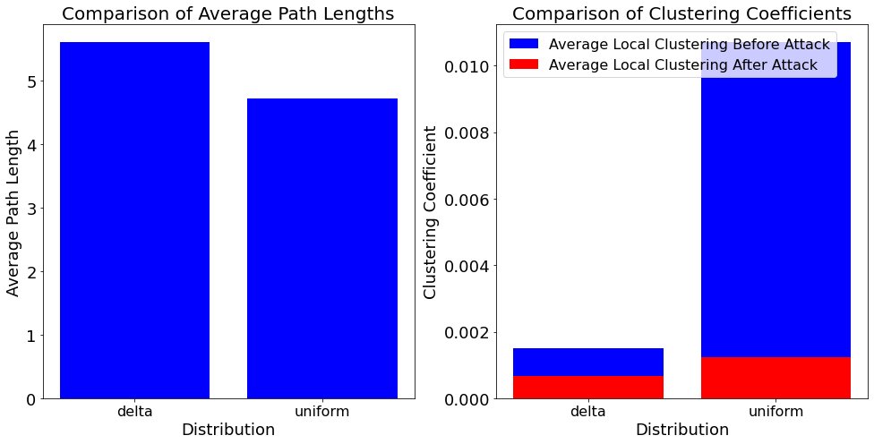
Network analysis
Analyze network:
Small work properties
Node overtaking
Robustness against attacks
 | Delta (BA-network) | Uniform (BB-network)
Degree assortativity | -0.0243 | -0.0604
Hubs | 0, 8, 2, 4, 7 | 6, 19, 8, 60 10
Connected components before attack | 1 | 1
Connected components after attack | 14 | 274

Slide 12
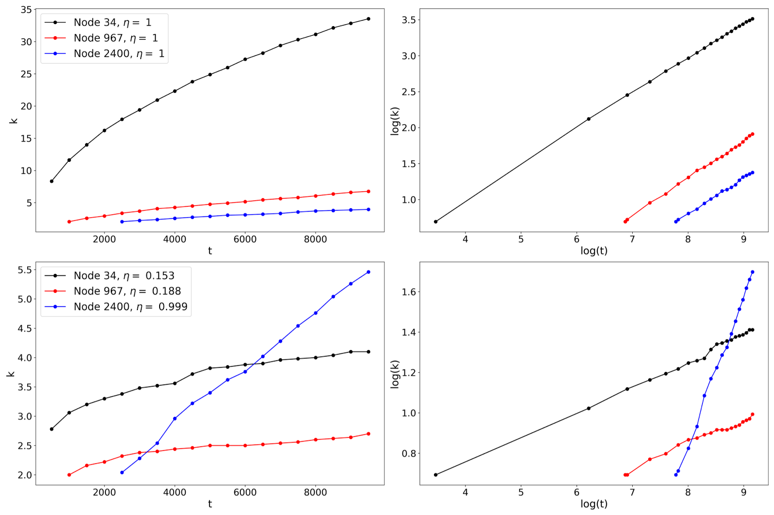
Degree dynamics comparison
Delta fitness distribution
Uniform fitness distribution

Slide 13
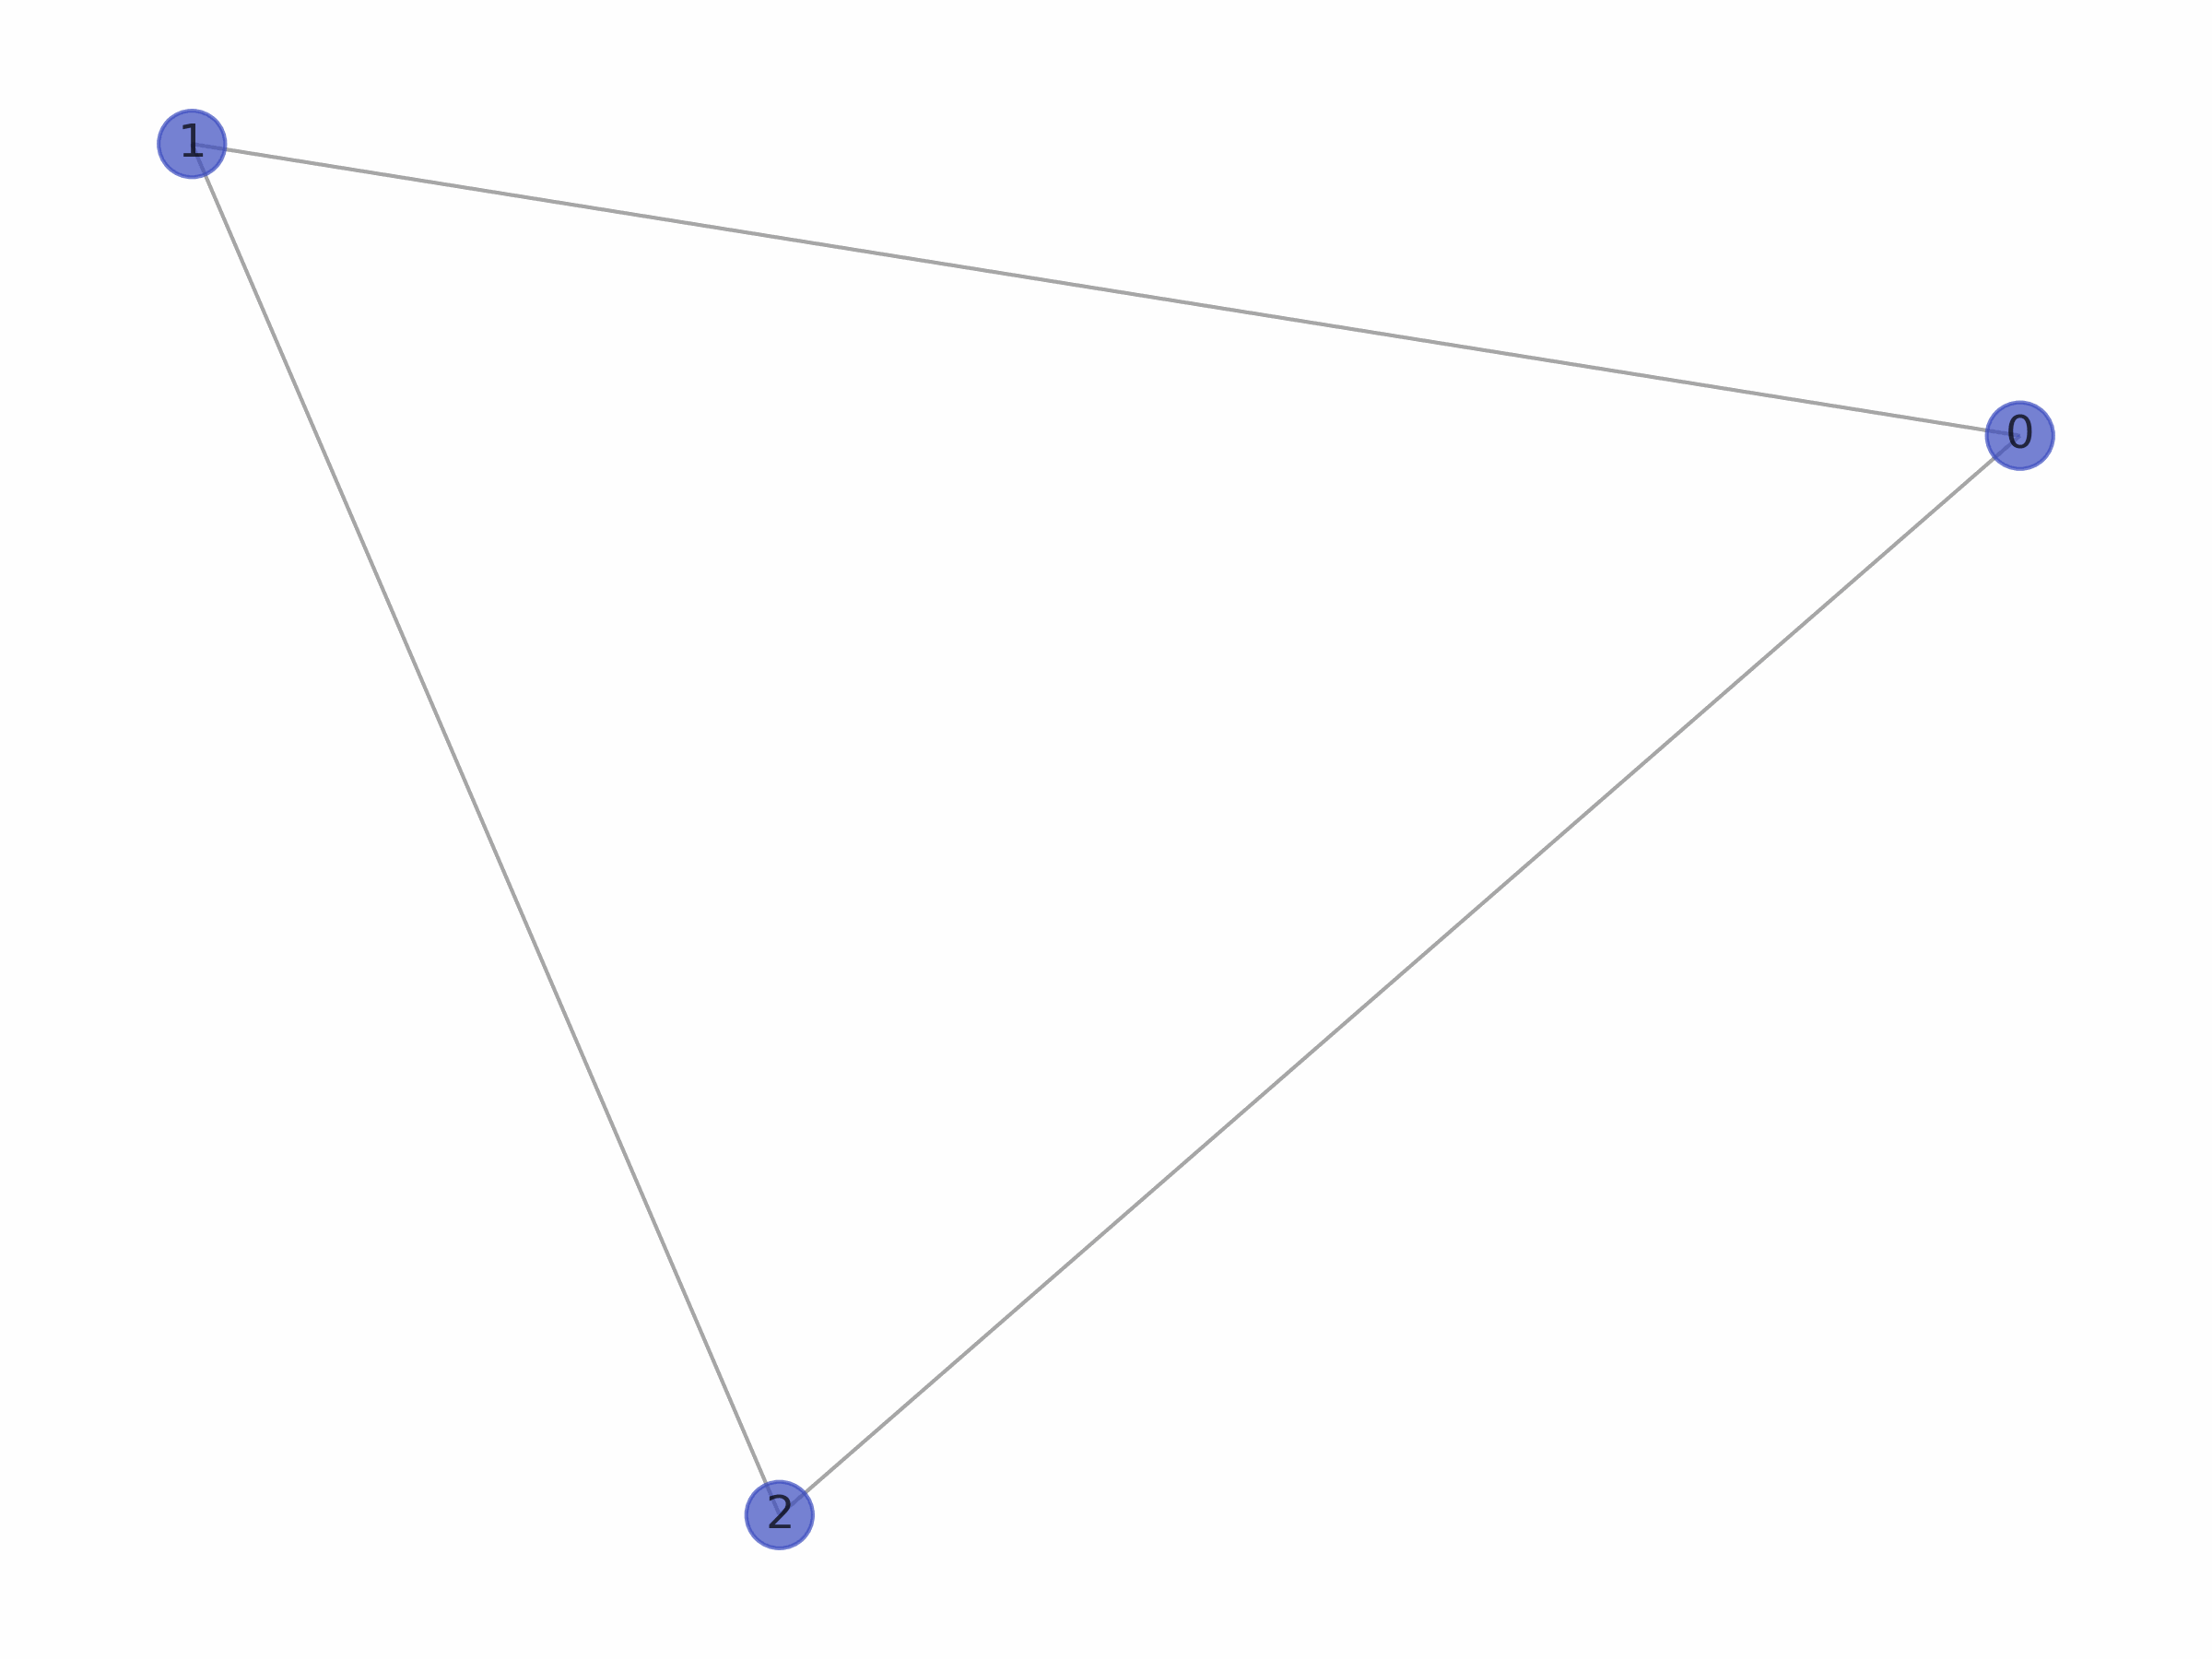
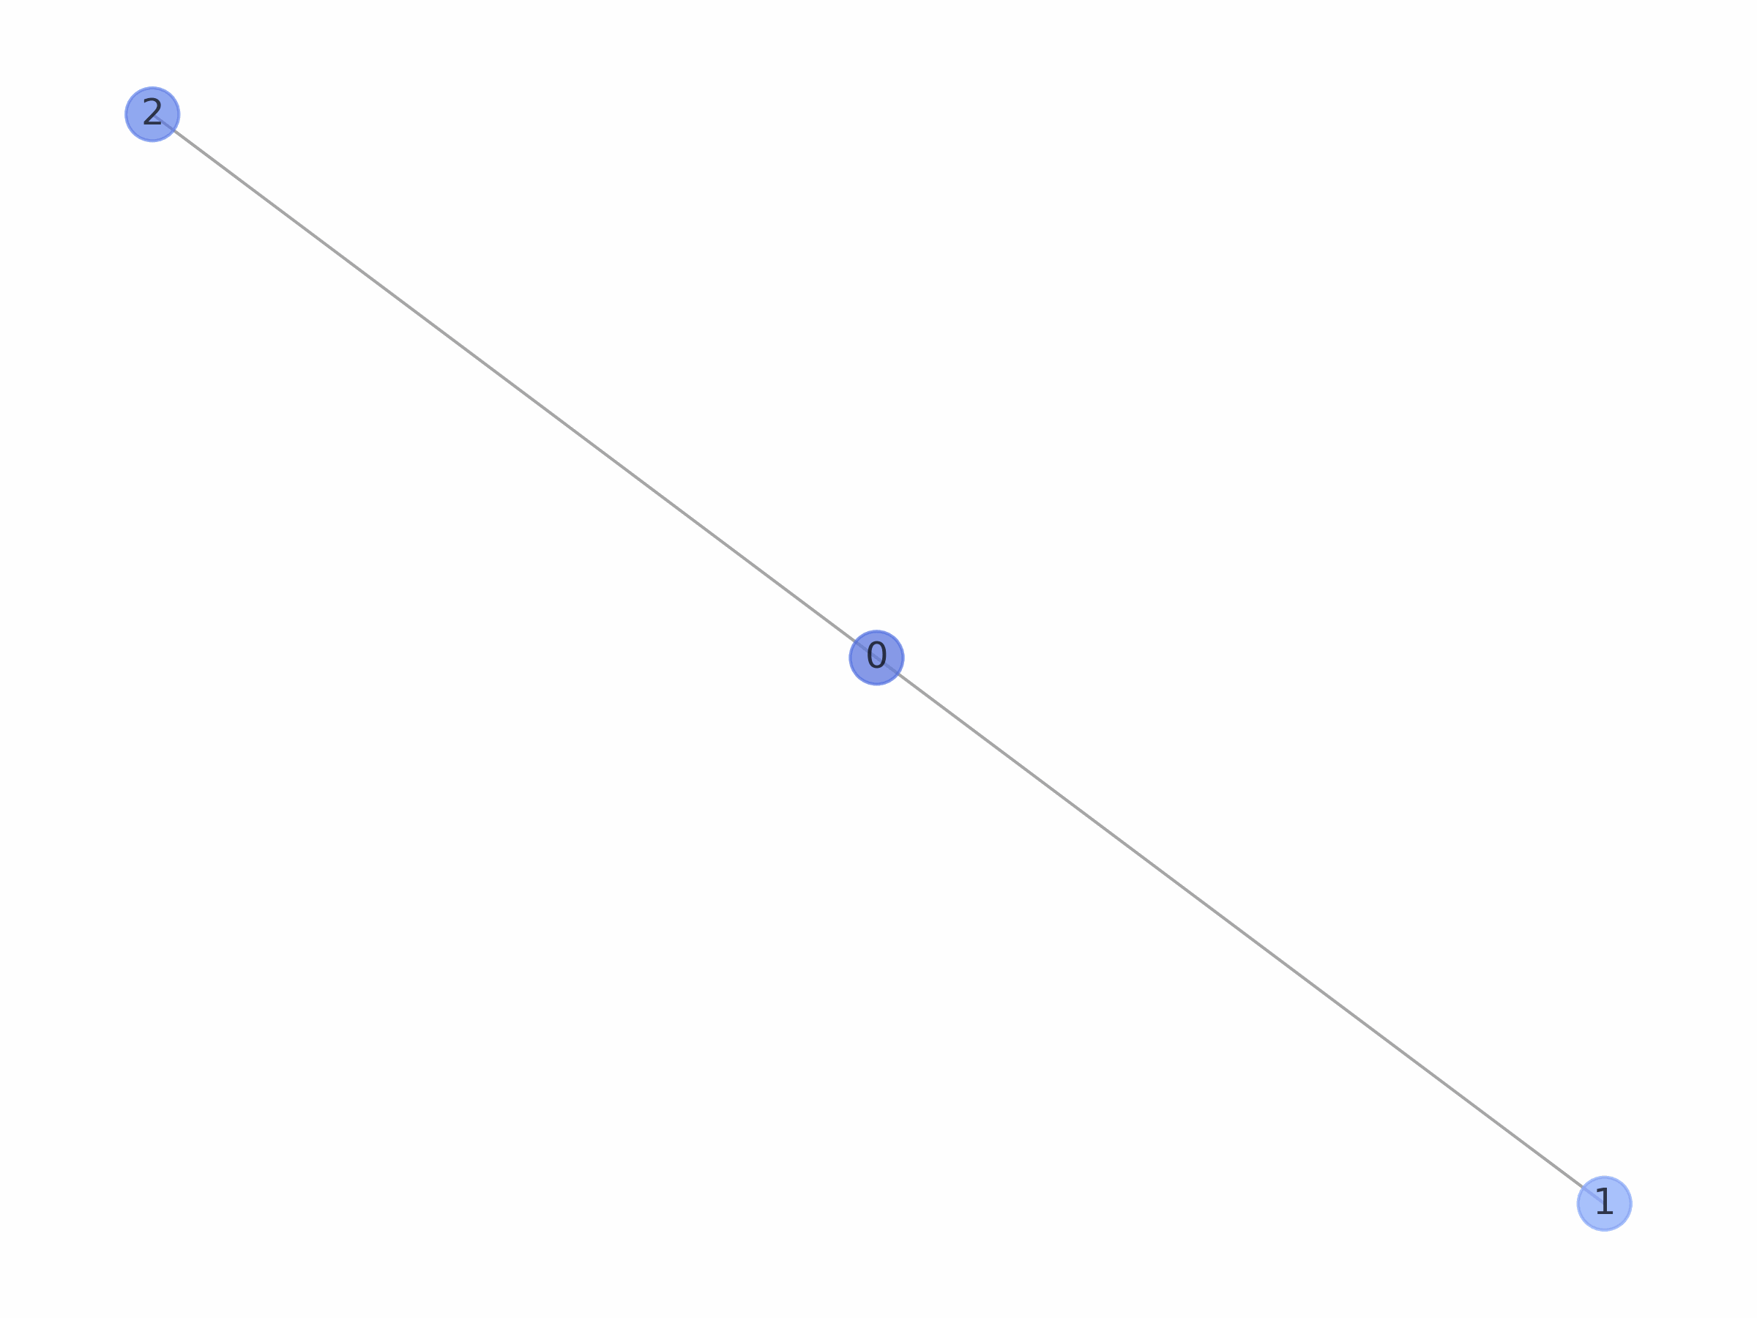
Analysis: Network visualization
Delta fitness distribution
Uniform fitness distribution

Slide 14
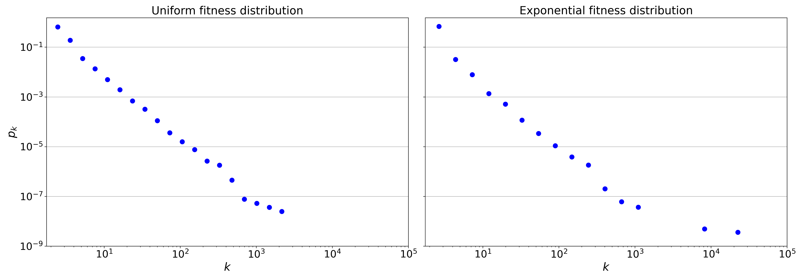
Analysis: Degree distributions

Slide 15
Uniform:
Analysis: Degree distributions
 | Power law | Truncated power law | Stretched exponential | Lognormal | Exponential | Lognormal positive
Truncated powerlaw | R + Significant | --- | R+ Not significant | R+ Not significant | R+ Significant | R+ Significant
Power Law | --- | R-, Significant | R-, Not significant | R+ Not significant | R+, Significant | R+ Significant
Stretched Exponential | R+ Not significant | R-, Not significant | --- | R+ Not significant | R + Significant | R + Significant
Exponential:
 | Power law | Truncated power law | Stretched exponential | Lognormal | Exponential | Lognormal positive
Truncated powerlaw | R + Significant | ---- | R+ Not significant | R+ Not significant | R+ Significant | R+ Significant
Power Law | --- | R-, Significant | R-, Not significant | R+ Not significant | R+, Significant | R+ Significant
Stretched Exponential | R+ Not significant | R-, Not significant | --- | R+ Not significant | R + Significant | R + Significant
Notes:
Uniform:
Calculating best minimal value for power law fit
truncated_power_law vs power_law: R = 1.7093, p = 0.0147
truncated_power_law vs lognormal: R = 1.1569, p = 0.2473
truncated_power_law vs exponential: R = 3.8789, p = 0.0001
truncated_power_law vs lognormal_positive: R = 621.8906, p = 0.0
truncated_power_law vs stretched_exponential: R = 0.9225, p = 0.3563
power_law vs lognormal: R = -1.1903, p = 0.2339
power_law vs exponential: R = 3.2549, p = 0.0011
power_law vs lognormal_positive: R = 567.0171, p = 0.0
power_law vs truncated_power_law: R = -1.7093, p = 0.0147
power_law vs stretched_exponential: R = -1.284, p = 0.1991
strechted_exponential vs power_law: R = 1.284, p = 0.1991
strechted_exponential vs lognormal: R = 1.1932, p = 0.2328
strechted_exponential vs exponential: R = 3.8522, p = 0.0 s
trechted_exponential vs lognormal_positive: R = 614.8755, p = 0.0
strechted_exponential vs truncated_power_law: R = -0.9225, p = 0.3563
Exponential
Calculating best minimal value for power law fit
truncated_power_law vs power_law: R = 1.0877, p = 0.1441
truncated_power_law vs lognormal: R = 1.1135, p = 0.2655
truncated_power_law vs exponential: R = 3.6457, p = 0.0003
truncated_power_law vs lognormal_positive: R = 512.1677, p = 0.0
truncated_power_law vs stretched_exponential: R = 0.9372, p = 0.3486
power_law vs lognormal: R = -0.6012, p = 0.5477
power_law vs exponential: R = 3.2553, p = 0.0011
power_law vs lognormal_positive: R = 479.4889, p = 0.0
power_law vs truncated_power_law: R = -1.0877, p = 0.1441
power_law vs stretched_exponential: R = -0.6505, p = 0.5154
strechted_exponential vs power_law: R = 0.6505, p = 0.5154
strechted_exponential vs lognormal: R = 0.8009, p = 0.4232
strechted_exponential vs exponential: R = 3.6279, p = 0.0
strechted_exponential vs lognormal_positive: R = 505.9862, p = 0.0
strechted_exponential vs truncated_power_law: R = -0.9372, p = 0.3486

Slide 16
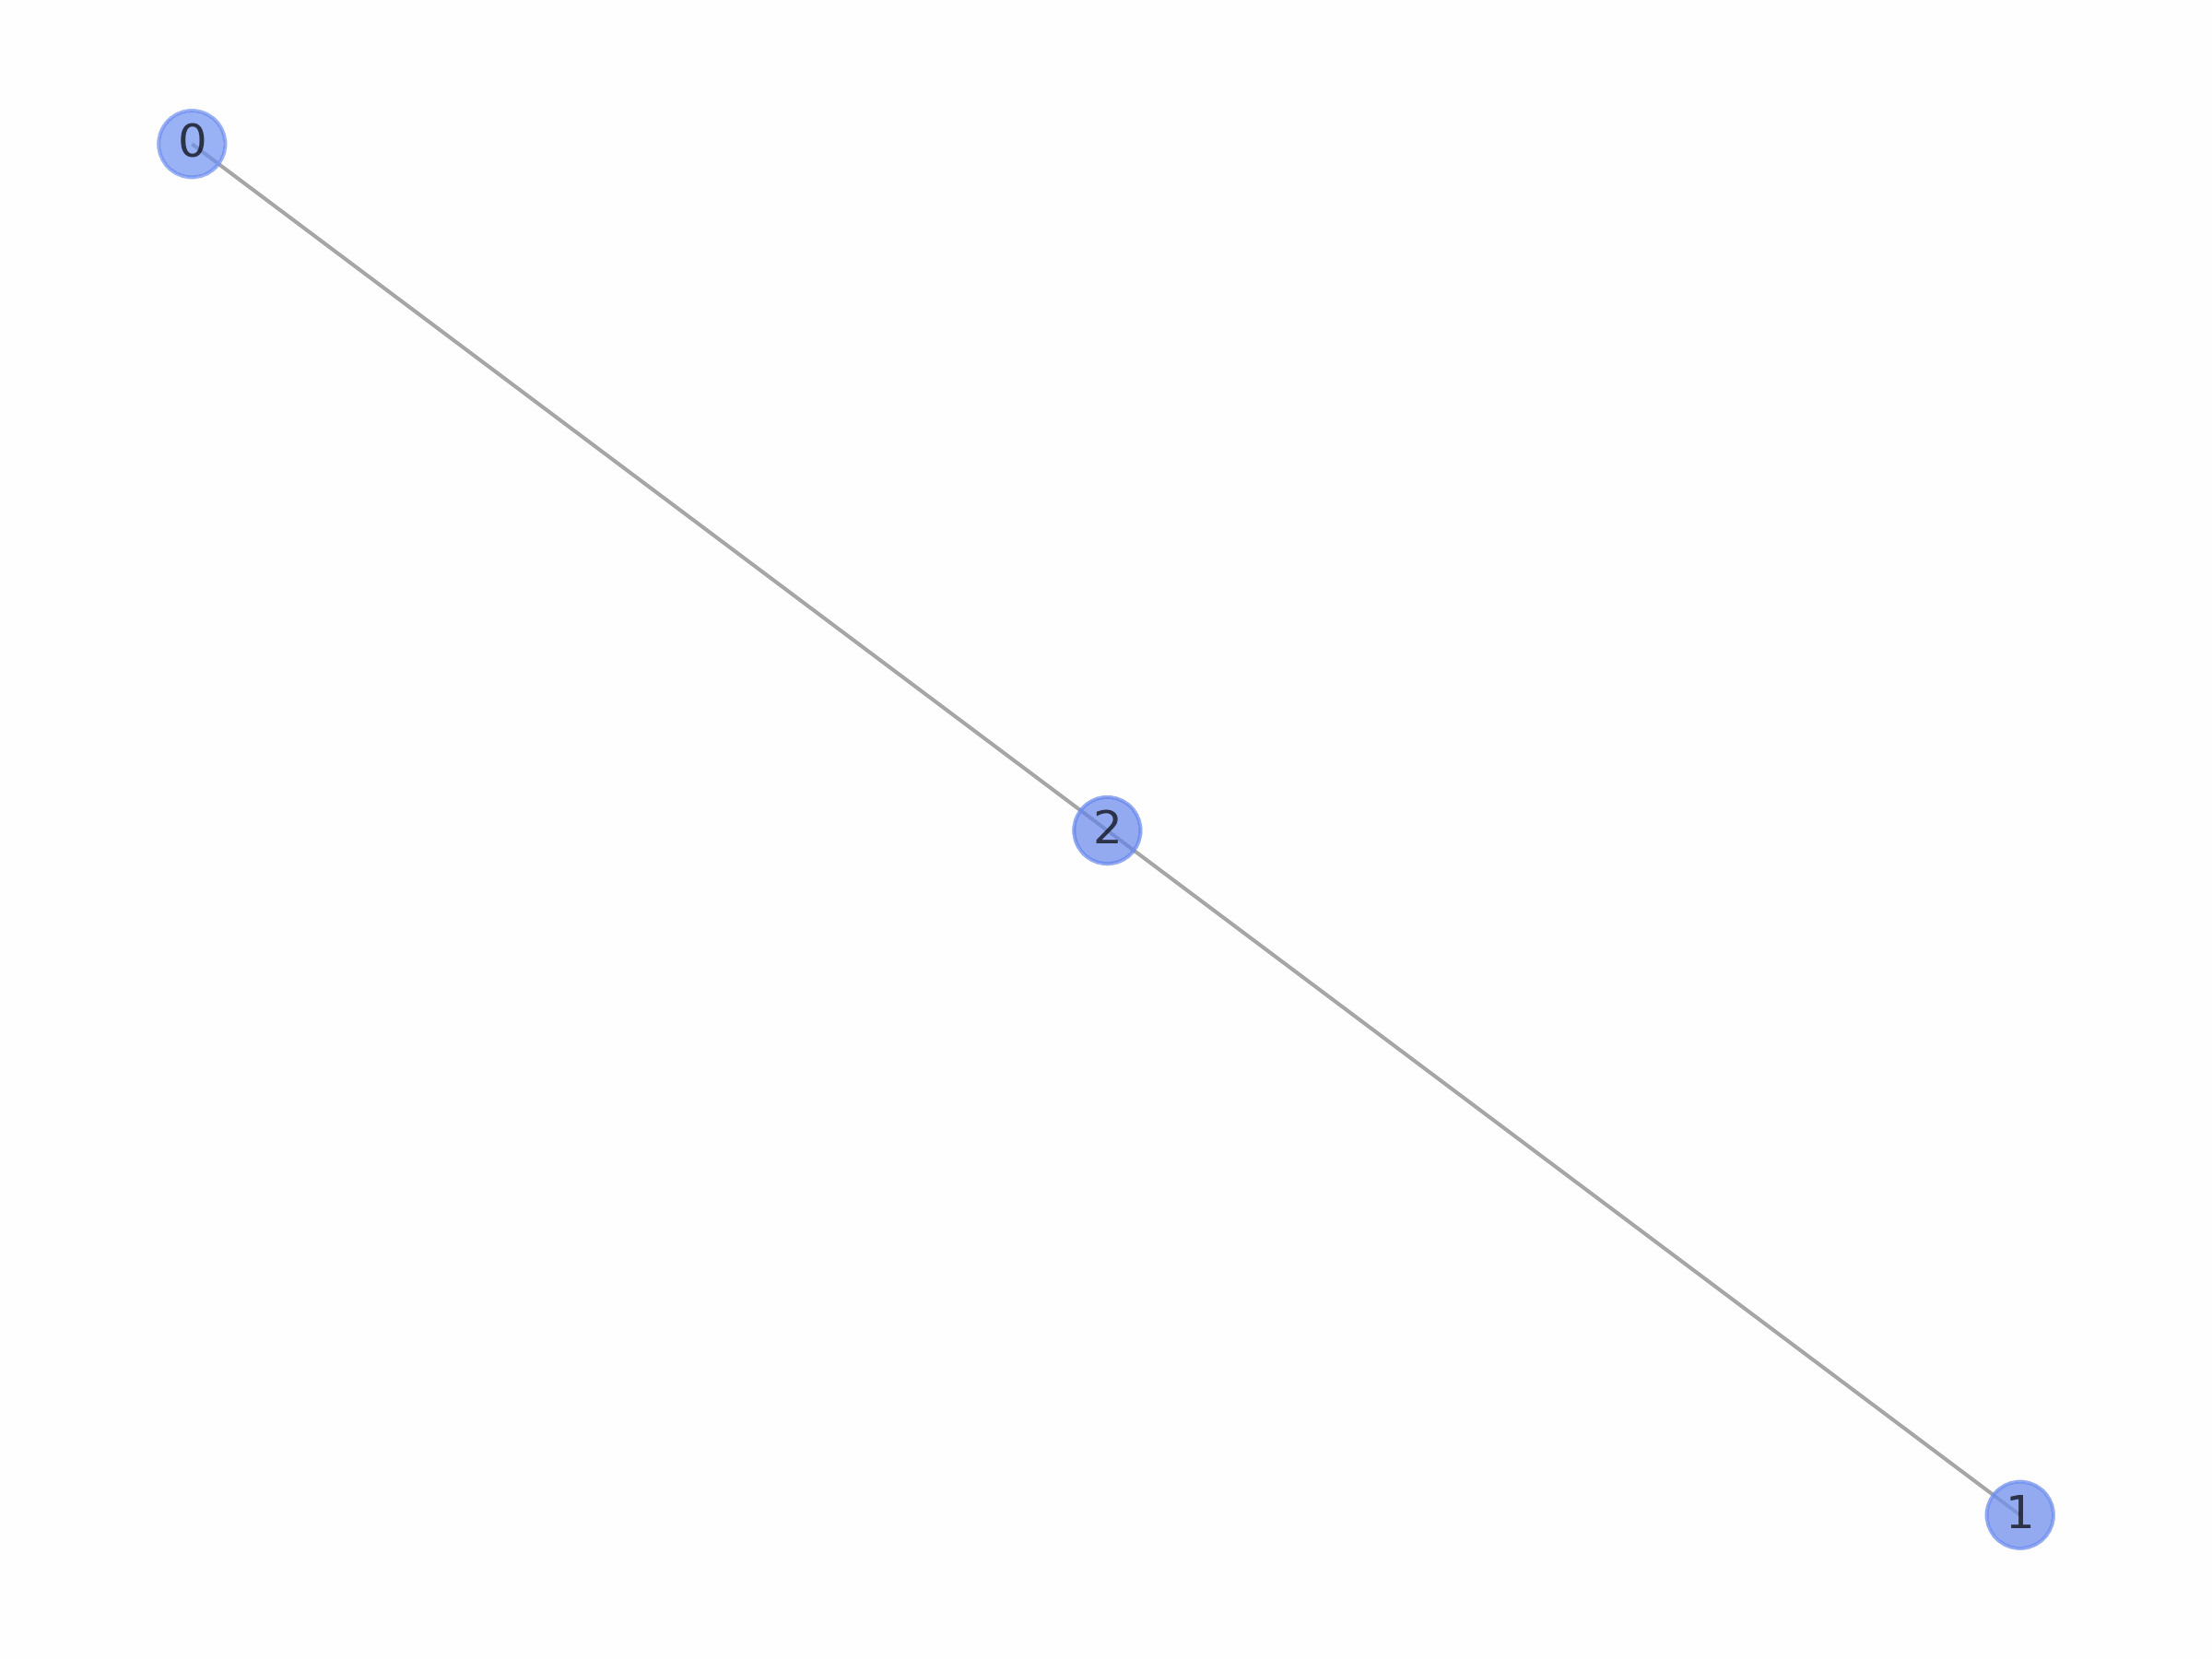
Analysis: Network visualization
Uniform fitness distribution
Exponential fitness distribution

Slide 17
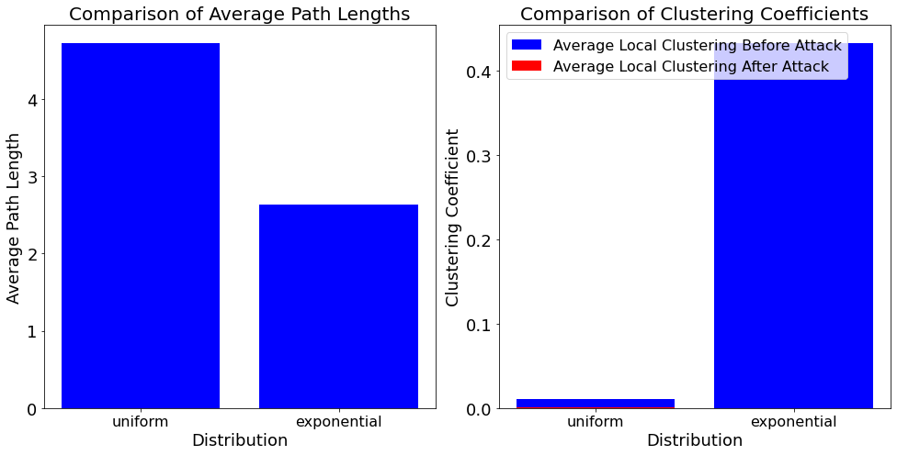
Network analysis
Analyze network:
Small work properties
Node overtaking
Robustness against attacks
 | Uniform (BB-network) | Exponential
Clustering coefficient before attack | 0.0107 | 0.4325
Clustering coefficient before attack | 0.0012 | 0.0002
Degree assortativity | -0.0604 | -0.3484
Hubs | 6, 19, 8, 60 10 | 18, 12, 73, 29, 24
Connected components before attack | 1 | 1
Connected components after attack | 274 | 13839

Slide 18
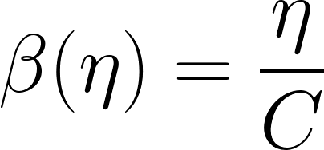
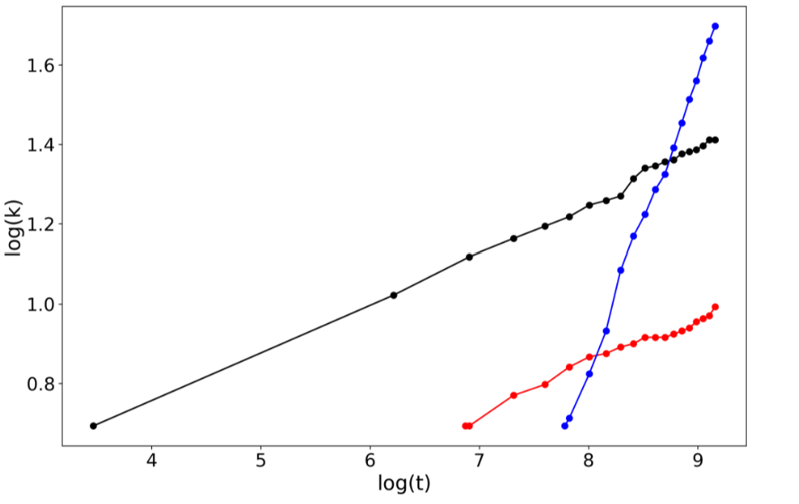
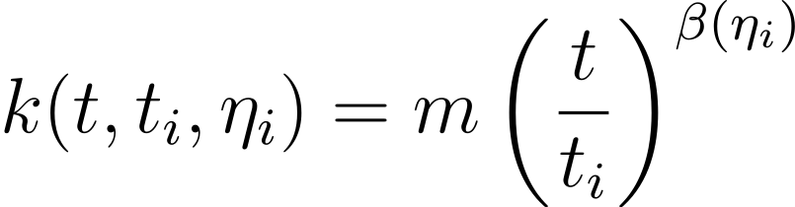
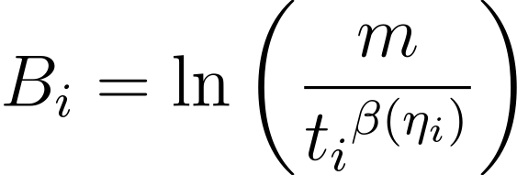
Fitness Estimation
Linear relation -> Linear regression

Slide 19
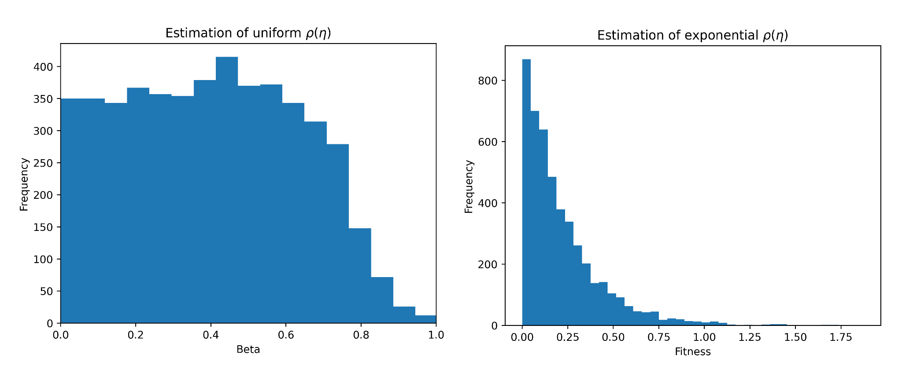
Fitness Estimation Results

Slide 20
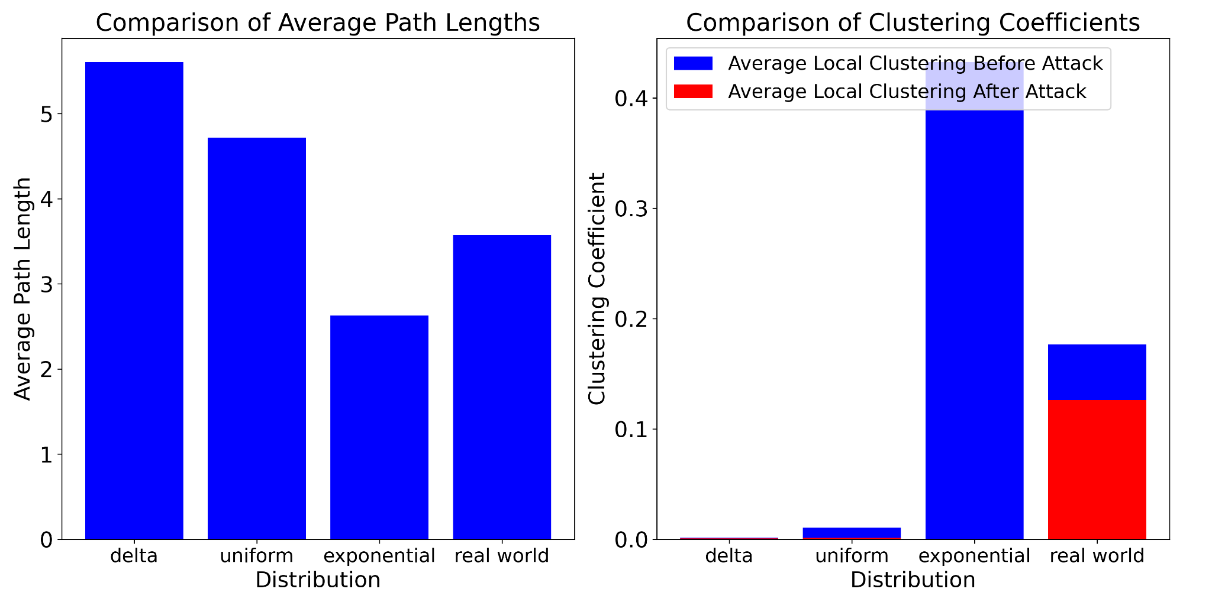
Real data
Analyze network:
Small work properties
Node overtaking
Robustness against attacks
 | Uniform (BB-network) | Exponential | Real World Network
Degree assortativity | -0.0604 | -0.3484 | -0.1685
Hubs | 6, 19, 8, 60 10 | 18, 12, 73, 29, 24 | 1,8,3,2,11
Connected components before attack | 1 | 1 | 5
Connected components after attack | 274 | 13839 | 338

Slide 21
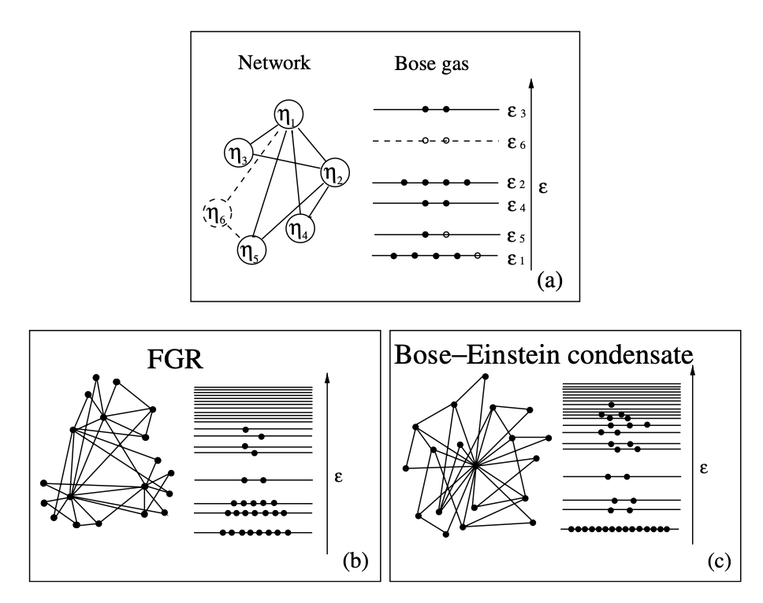
Phase transition: Bose-Einstein condensation
Bianconi, G., & Barabási, A. L. (2001). Bose-Einstein condensation in complex networks. Physical review letters, 86(24), 5632.

Slide 22
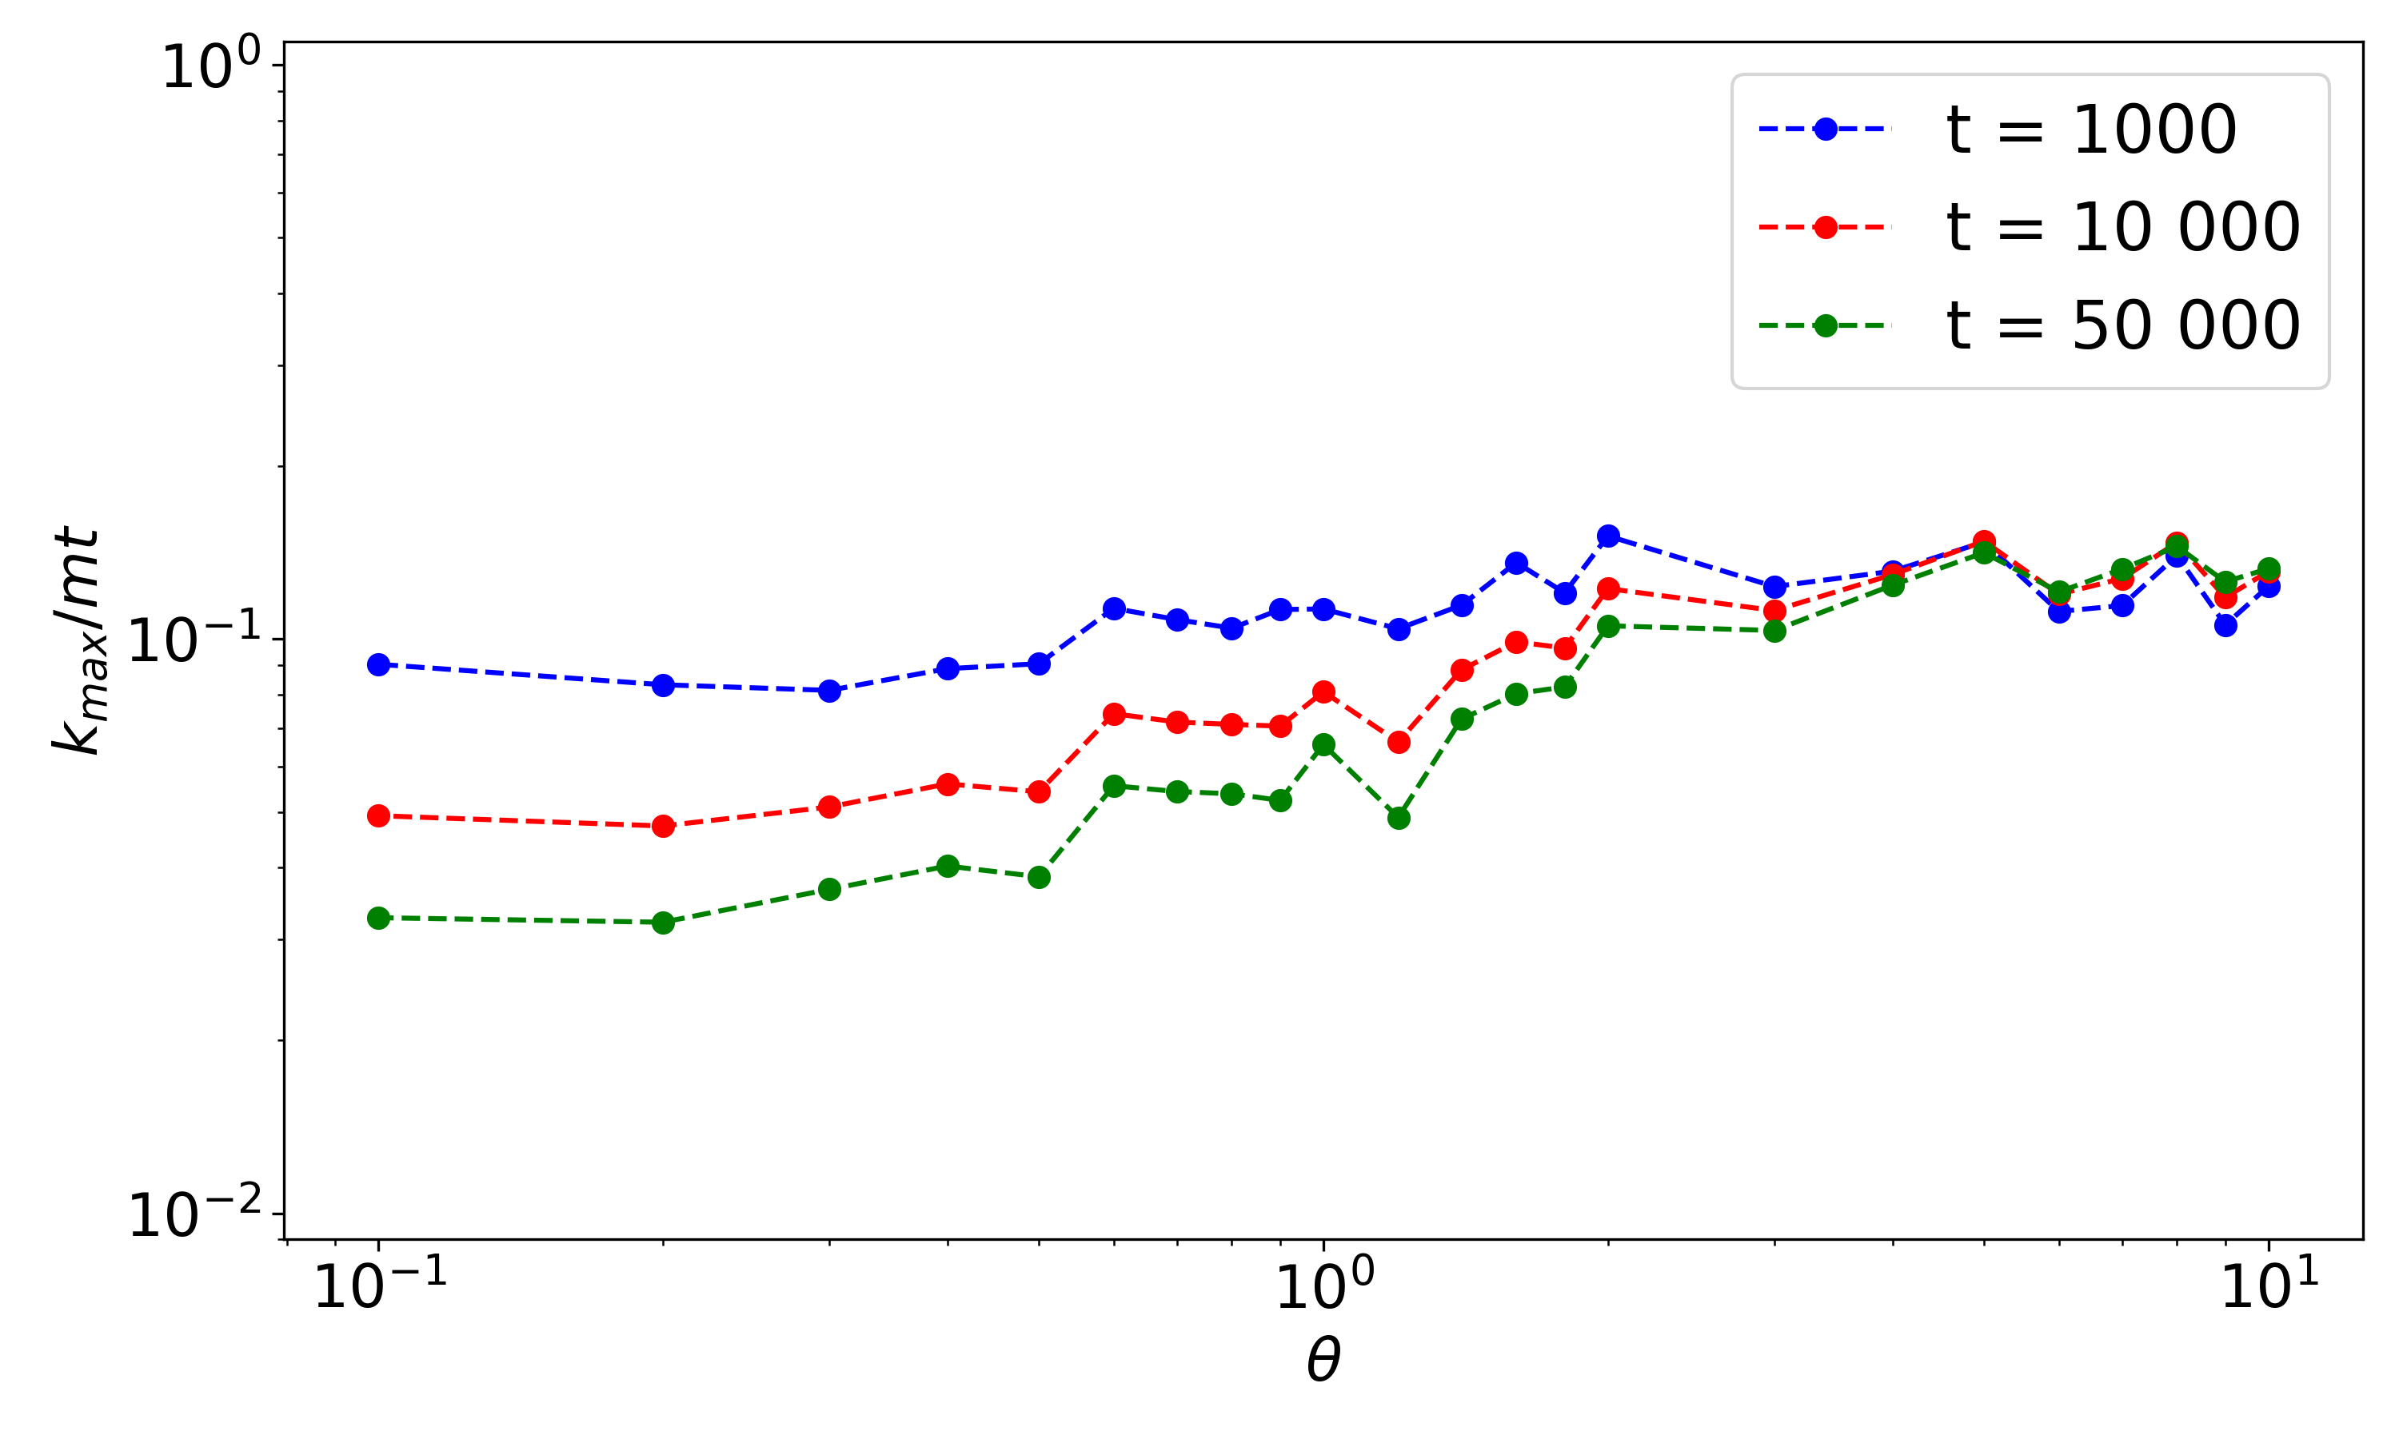
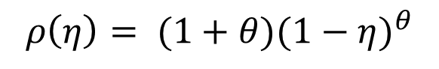
Phase transition: Bose-Einstein condensation
$$ρ\left(η\right)= (1+θ){(1−η)}^{θ}$$

Slide 23
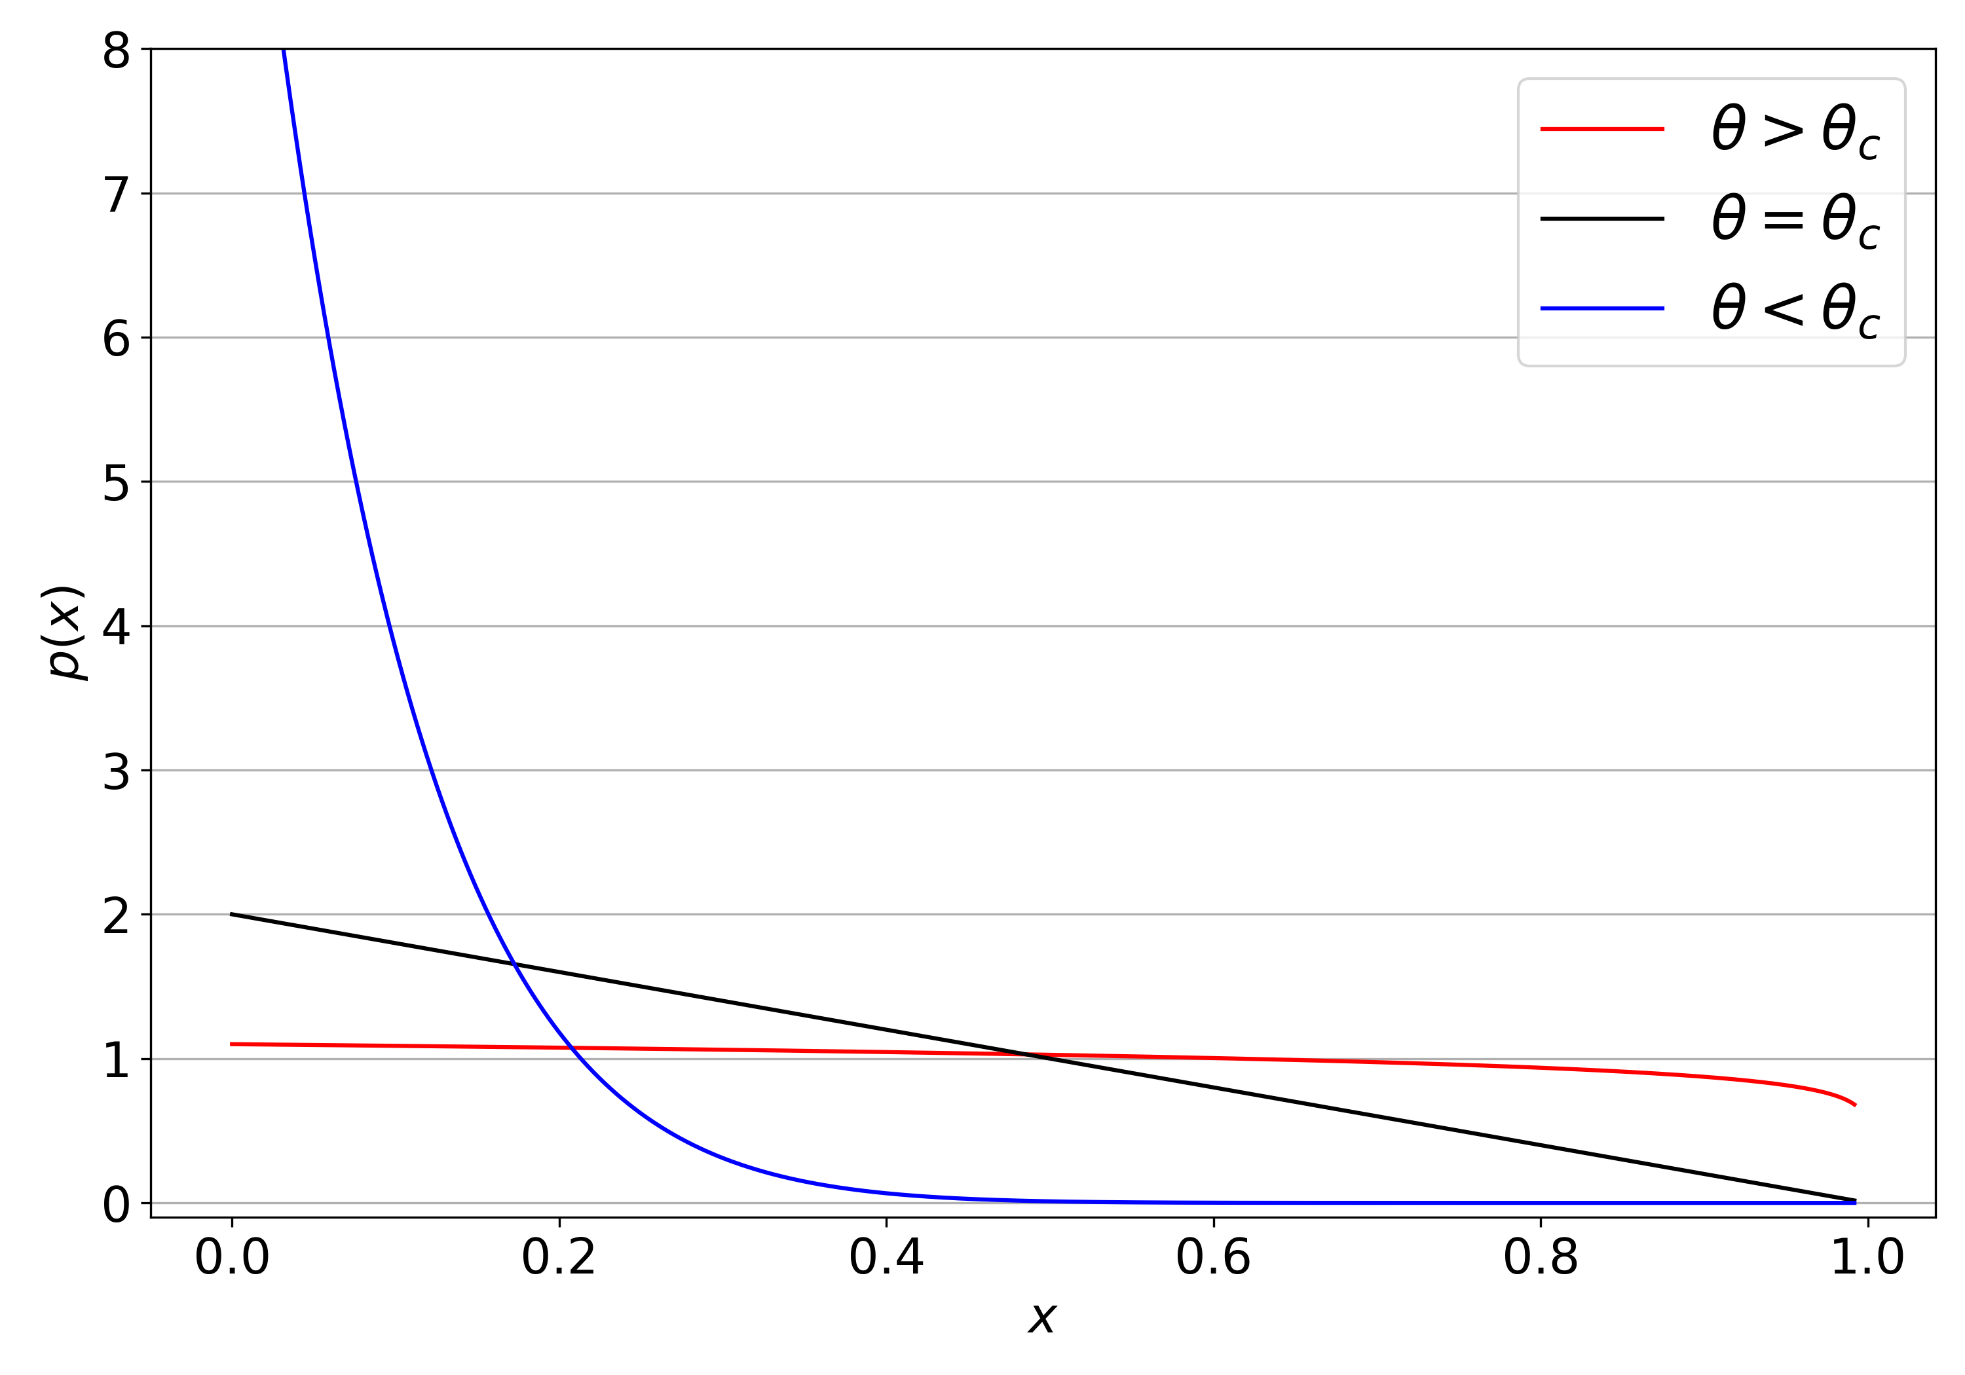
Phase transition: Bose-Einstein condensation

Slide 24
Conclusion
Introduction of fitness allows later nodes to surpass earlier nodes in the network
Fitness distribution influences the complete change in network topology.
Our model partially replicates certain properties of the real network but differs in many aspects
We estimated the fitness distribution shape in the averaged network generated by our model.
The bianconi barabasi model exhibits a phase transition similar to Bose-Einstein condensation, where the degree distribution changes depending on fitness.

Slide 25
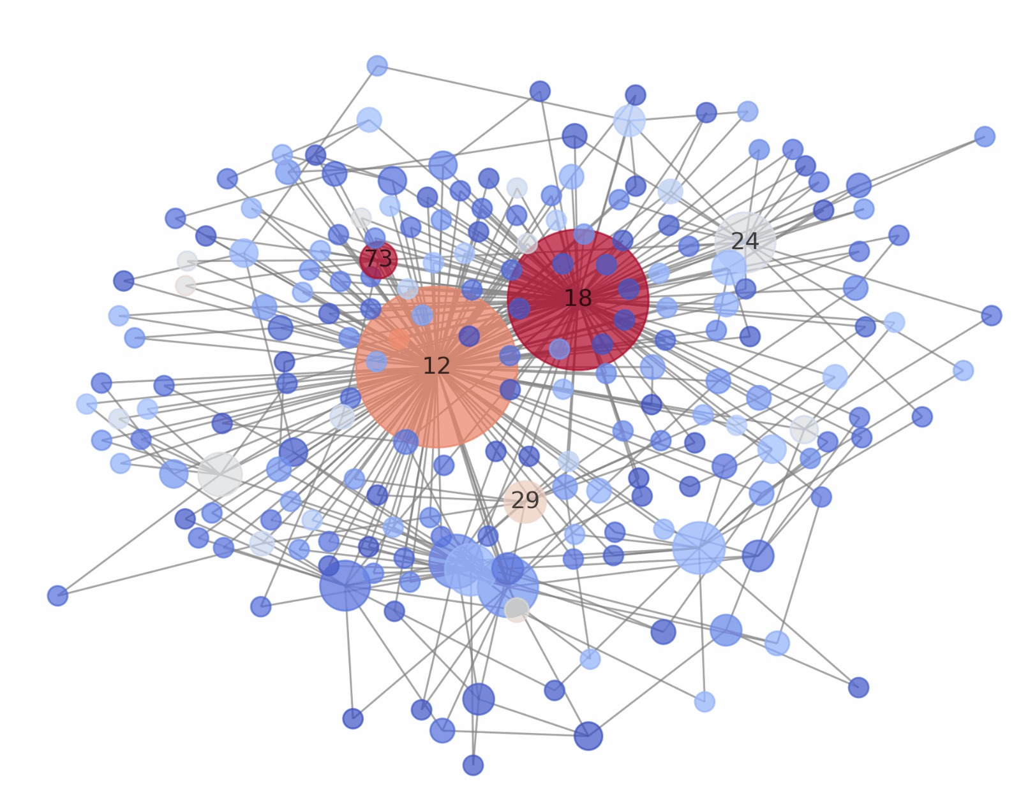
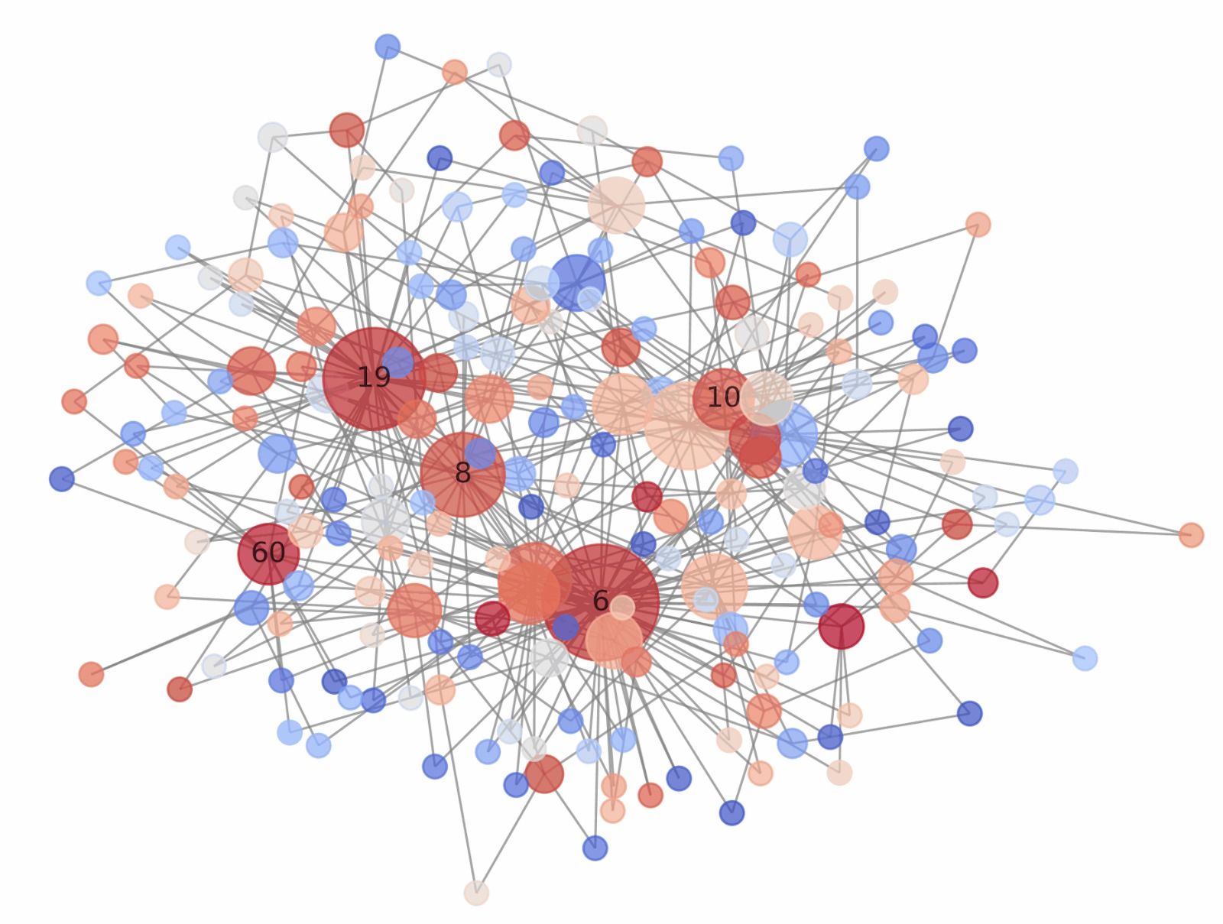
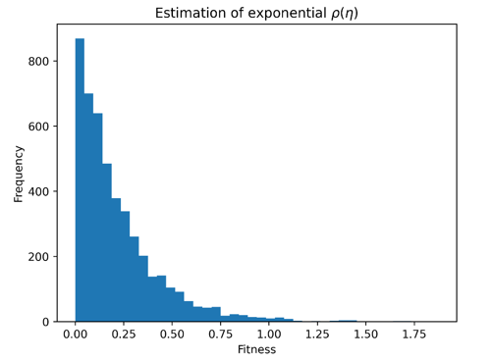
Conclusion

Slide 26
Questions

